Slide 1
Information Security
Week 05, Class 01

Slide 2
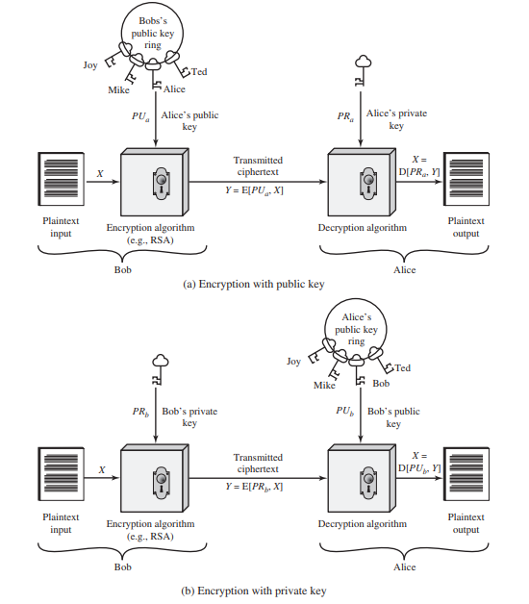

Slide 3
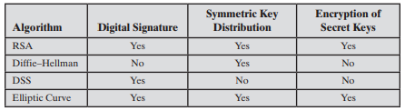
Applications for Public-Key Cryptosystems

Slide 4
FIPS 186-4 specifies digital signature algorithms:
Digital Signature Algorithm (DSA): The original NIST-approved algorithm, which is based on the difficulty of computing discrete logarithms.
RSA Digital Signature Algorithm: Based on the RSA public-key algorithm.
Elliptic Curve Digital Signature Algorithm (ECDSA): Based on elliptic-curve cryptography.

Slide 5
Digital Signature
Digital Signature Standard (DSS)
The result of a cryptographic transformation of data that, when properly implemented, provides:
a mechanism for verifying origin authentication,
data integrity and,
signatory non-repudiation.
“data-dependent bit pattern”

Slide 6
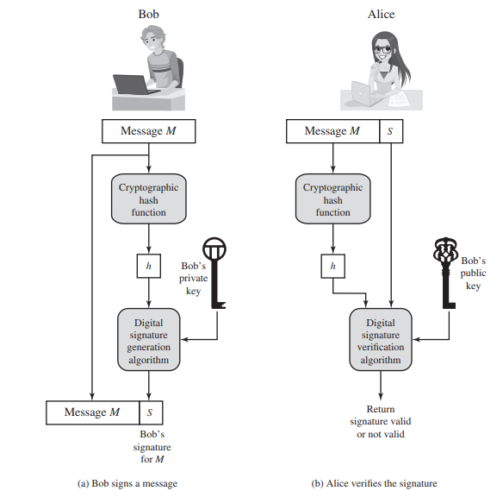

Slide 7
Public-Key Certificates
A certificate consists of a public key plus a user ID of the key owner,
With the whole block signed by a trusted third party.
The certificate also includes some information about the third party plus,
An indication of the period of validity of the certificate

Slide 8
key steps
User software (client) creates a pair of keys: one public and one private.
Client prepares an unsigned certificate that includes the user ID and user’s public key.
User provides the unsigned certificate to a CA in some secure manner. This might require a face-to-face meeting, the use of registered e-mail, or happen via a Web form with e-mail verification.
CA creates a signature as follows:
a. CA uses a hash function to calculate the hash code of the unsigned certificate. A hash function is one that maps a variable-length data block or message into a fixed-length value called a hash code.
b. CA generates digital signature using the CA’s private key and a signature generation algorithm.
CA attaches the signature to the unsigned certificate to create a signed certificate

Slide 9
CA returns the signed certificate to client.
Client may provide the signed certificate to any other user.
Any user may verify that the certificate is valid as follows:
a. User calculates the hash code of certificate (not including signature).
b. User verifies digital signature using CA’s public key and the signature verification algorithm. The algorithm returns a result of either signature valid or invalid

Slide 10
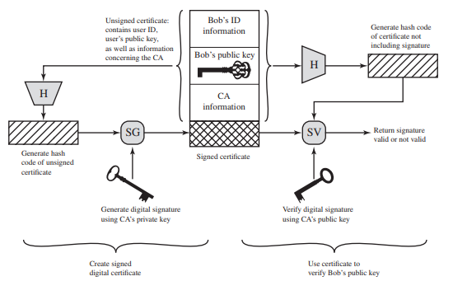

Slide 11
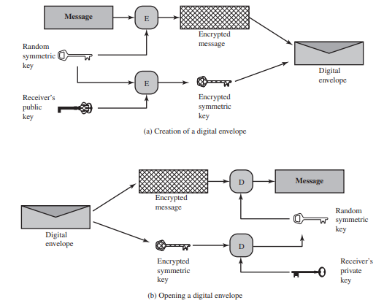
Digital Envelopes

Slide 12
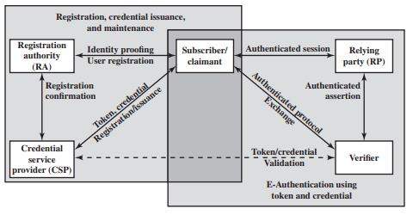
DIGITAL USER AUTHENTICATION
The process of establishing confidence in user identities that are presented electronically to an information system.
The NIST SP 800-63-3
E-Authentication Architectural Model

Slide 13
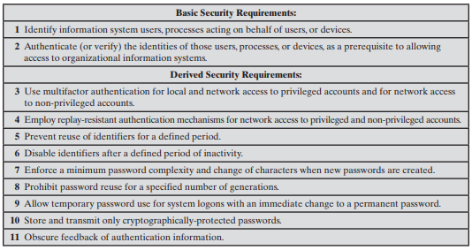
Identification and Authentication Security Requirements (NIST SP 800-171)

Slide 14
Means of Authentication
Something the individual knows: Examples include a password, a personal identification number (PIN), or answers to a pre-arranged set of questions.
Something the individual possesses: Examples include electronic keycards, smart cards, and physical keys. This type of authenticator is referred to as a token.
Something the individual is (static biometrics): Examples include recognition by fingerprint, retina, and face.
Something the individual does (dynamic biometrics): Examples include recognition by voice pattern, handwriting characteristics, and typing rhythm.

Slide 15
Week 05, Class 02

Slide 16
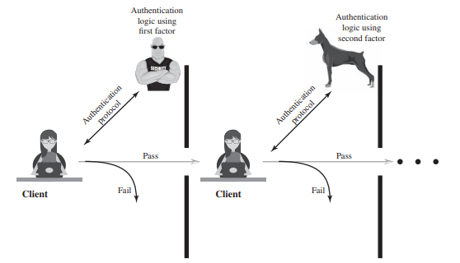
Assurance Level
Level 1: Little or no confidence in the asserted identity’s validity.
Level 2: Some confidence in the asserted identity’s validity.
Level 3: High confidence in the asserted identity’s validity.
Level 4: Very high confidence in the asserted identity’s validity.
Multifactor Authentication

Slide 17
Potential Impact
Low: At worst, an insignificant or inconsequential unrecoverable financial loss to any party, or at worst, an insignificant or inconsequential organization liability.
Moderate: At worst, a serious unrecoverable financial loss to any party, or a serious organization liability.
High: Severe or catastrophic unrecoverable financial loss to any party; or severe or catastrophic organization liability

Slide 18
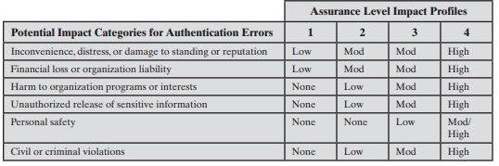
Maximum Potential Impacts for Each Assurance Level
This table suggests a technique for doing risk assessment. For a given information system or service asset of an organization, the organization needs to determine the level of impact if an authentication failure occurs, using the categories of impact, or risk areas, that are of concern.
Read Assurance levels, Potential risk, Risk from the book

Slide 19
PASSWORD-BASED AUTHENTICATION
A widely used line of defense against intruders is the password system.
The ID determines whether the user is authorized to gain access to a system.
The ID determines the privileges accorded to the user.
The ID is used in what is referred to as discretionary access control.

Slide 20
The Vulnerability of Passwords
Offline dictionary attack.
Specific account attack.
Popular password attack.
Password guessing against single user.
Workstation hijacking.
Exploiting user mistakes.
Exploiting multiple password use.
Electronic monitoring.

Slide 21
Reasons for the persistent popularity of passwords
Techniques that utilize client-side hardware, such as fingerprint scanners and smart card readers.
Physical tokens, such as smart cards, are expensive and/or inconvenient to carry around, especially if multiple tokens are needed.
Schemes that rely on a single sign-on to multiple services, using one of the non-password techniques described in this chapter, create a single point of security risk.
Automated password managers that relieve users of the burden of knowing and entering passwords have poor support for roaming and synchronization across multiple client platforms, and their usability had not be adequately researched.

Slide 22
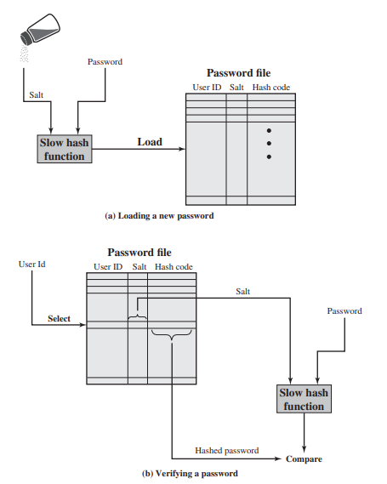
The Use of Hashed Passwords

Slide 23
Password Cracking of User-Chosen Passwords
Password guessing, or password cracking as it is called, is to develop a large dictionary of possible passwords and to try each of these against the password file.
For example, [OECH03] showed that using 1.4 GB of data, he could crack 99.9% of all alphanumeric Windows password hashes in 13.8 seconds.

Slide 24
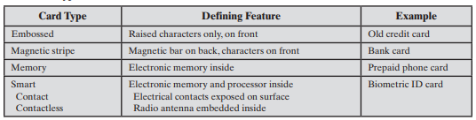
TOKEN-BASED AUTHENTICATION
Objects that a user possesses for the purpose of user authentication are called tokens.
Memory Cards: Memory cards can store but not process data.
The memory card, when combined with a PIN or password, provides significantly greater security than a password alone.
Token loss: A lost token temporarily prevents its owner from gaining system access. Thus, there is an administrative cost in replacing the lost token. In addition, if the token is found, stolen, or forged, then an adversary need only determine the PIN to gain unauthorized access.
User dissatisfaction: Although users may have no difficulty in accepting the use of a memory card for ATM access, its use for computer access may be deemed inconvenient

Slide 25
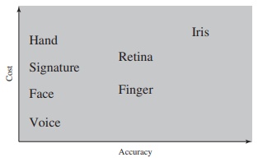
BIOMETRIC AUTHENTICATION
A biometric authentication system attempts to authenticate an individual based on his or her unique physical characteristics.
Facial characteristics
Fingerprints
Hand geometry
Retinal pattern
Iris
Signature/Hand writing pattern
Voice

Slide 26
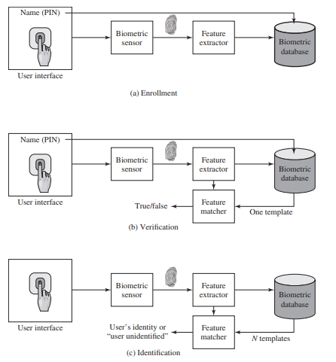
Operation of a Biometric Authentication System

Slide 27
Week 05, Class 03

Slide 28
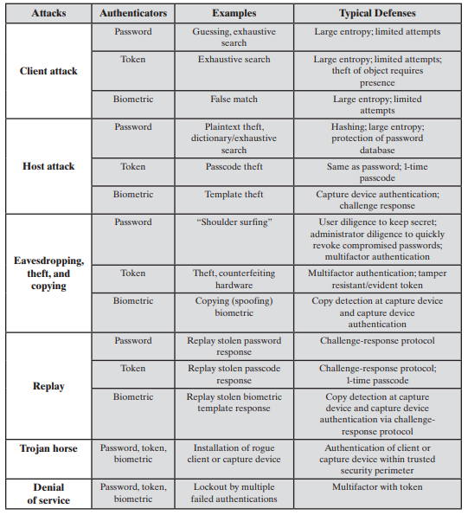
Some Potential Attacks,
Susceptible Authenticators, and
Typical Defenses

